Slide 1
TREES
General trees
Binary trees
Binary search trees
AVL trees
Balanced and Threaded trees.

Slide 2
General Trees.
Trees can be defined in two ways :
Recursive
Non- recursive
A
B
C
D
E
F
G
H
J
I
One natural way to define a tree is
recursively
K

Slide 3
General trees-Definition
A tree is a collection of nodes. The collection can be empty; otherwise a tree consists of a distinguish node r, called root, and zero or more non-empty (sub)trees T₁,T₂,T₃,….T_{K.} .
Each of whose roots are connected by a directed edge from r.
A
B
C
D
E
F
G
H
J
I
K

Slide 4
General trees-Definition
A tree consists of set of nodes and set of edges that connected pair of nodes.
A
B
C
D
E
F
G
H
J
I
K

Slide 5
Eg. A table of contents and its tree representation
Book
  C1
    S1.1
    S1.2
  C2
    S2.1
      S2.1.1
      S2.1.2
    S2.2
    S2.3
  C3
Book
C1
C2
C3
S1.1
S1.2
S2.1
S2.2
S2.3
S2.1.1
S2.1.2

Slide 6
Degree
The number of sub tree of a node is called its degree.
Eg. Degree of book → 3, C1→2,C3→0
Book
C1
C2
C3
S1.1
S1.2
S2.1
S2.2
S2.3
S2.1.1
S2.1.2

Slide 7
Terminal Nodes and Non Terminal nodes
Nodes that have degree 0 is called Leaf or Terminal node.Other nodes called non-terminal nodes. Eg.Leaf nodes :C3,S1.1,S1.2 etc.
Book
C1
C2
C3
S1.1
S1.2
S2.1
S2.2
S2.3
S2.1.1
S2.1.2

Slide 8
Parent, Children & Siblings
Book is said to be the father (parent) of C1,C2,C3 and C1,C2,C3 are said to be sons (children ) of book.
Children of the same parent are said to be siblings.
Eg.C1,C2,C3 are siblings (Brothers)
Book
C1
C2
C3
S1.1
S1.2
S2.1
S2.2
S2.3
S2.1.1
S2.1.2

Slide 9
Length
The length of a path is one less than the number of nodes in the path.(Eg path from book to s1.1=3-1=2)
Book
C1
C2
C3
S1.1
S1.2
S2.1
S2.2
S2.3
S2.1.1
S2.1.2

Slide 10
Ancestor & Descendent
If there is a path from node a to node b , then a is an ancestor of b and b is descendent of a.
In above example, the ancestor of S2.1 are itself,C2 and book, while it descendent are itself, S2.1.1 and S2.1.2.
Book
C1
C2
C3
S1.1
S1.2
S2.1
S2.2
S2.3
S2.1.1
S2.1.2

Slide 11
Height & Depth
The height of a node in a tree is the length of a longest path from node to leaf.[ In above example node C1 has height 1, node C2 has height 2.etc.
Depth : The depth of a tree is the maximum level of any leaf in the tree.[ In above example depth=3]
Book
C1
C2
C3
S1.1
S1.2
S2.1
S2.2
S2.3
S2.1.1
S2.1.2

Slide 12
Tree - Implementation :
Keep the children of each node in a linked list of tree nodes. Thus each node keeps two references : one to its leftmost child and other one for its right sibling.
Left
Data
Right

Slide 13
Left child -Right sibling representation of a tree
A
C
B
E
D
F
G

Slide 14
A
B
C
D
F
G

Slide 15
Data structure definition
Class Treenode
{
Object element;
Treenode leftchild;
Treenode rightsibling;
}

Slide 16
An application :File system
There are many applications for trees. A popular one is the directory structure in many common operating systems, including VAX/VMX,Unix and DOS.

Slide 17
Binary trees
A binary tree is a tree in which no nodes can have more than two children.
The recursive definition is that a binary tree is either empty or consists of a root, a left tree, and a right tree.
The left and right trees may themselves be empty; thus a node with one child could have a left or right child. We use the recursive definition several times in the design of binary tree algorithms.

Slide 18
One use of the binary tree is in the expression tree, which is central data structure in compiler design.
Eg :
(a+((b-c)*d))
+
The leaves of an expression tree are operands, such as constant, variable names. The other nodes contain operators.
a
*
-
d
b
c

Slide 19
Tree traversal-iterate classes.
The main tree traversal techniques are:
  Pre-order traversal
  In-order traversal
  Post-order traversal

Slide 20
Pre-order traversal
To traverse a non-empty binary tree in pre-order (also known as depth first order), we perform the following operations.
Visit the root ( or print the root)
Traverse the left in pre-order (Recursive)
Traverse the right tree in pre-order (Recursive)

Slide 21
Pre-order traversal
1
Visit the root ( or print the root)
Traverse the left in pre-order (Recursive)
Traverse the right tree in pre-order (Recursive)
2
3
4
5
6
7
8
9
10
Pre-order list –1,2,3,5,8,9,6,10,4,7

Slide 22
In-order traversal
Traverse the left-subtree in in-order
Visit the root
Traverse the right-subtree in in-order.
1
2
3
4
5
6
7
8
9
10
Pre-order list –2,1,8,5,9,3,10,6,7,4

Slide 23
post-order traversal
1
Traverse the left sub-tree in post-order
Traverse the right sub-tree in post-order
Visit the root
2
3
4
5
6
7
8
9
10
Pre-order list –2,8,9,5,10,6,3,7,4,1

Slide 24
Properties of binary trees.
If a binary tree contains m nodes at level L, then it contains at most 2m nodes at level L+1.
A binary tree can contain at most 2^{L} nodes at L
At level 0 B-tree can contain at most 1= 2⁰ nodes
At level 1 B-tree can contain at most 2= 2¹ nodes
At level 2 B-tree can contain at most 4= 2²
nodes
At level L B-tree can contain at most → 2^{L} nodes

Slide 25
Complete B-tree
A complete B-tree of depth d is the B-tree that contains exactly 2^{L} nodes at each level between 0 and d ( or 2^{d} nodes at d)
Not a Complete B-tree
Complete B-tree

Slide 26
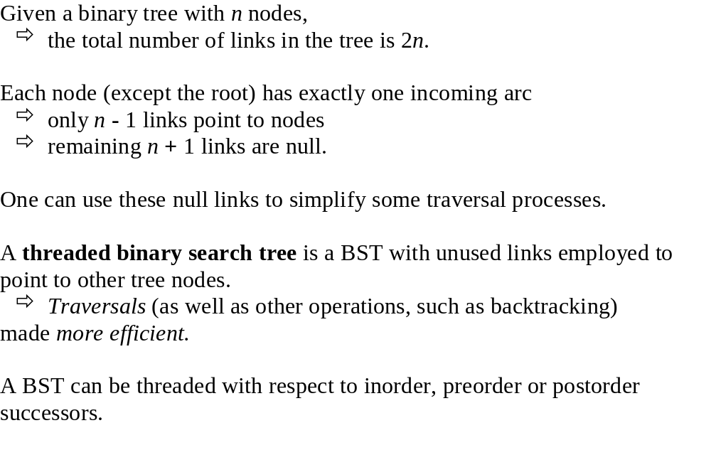
Threaded Binary Trees

Slide 27
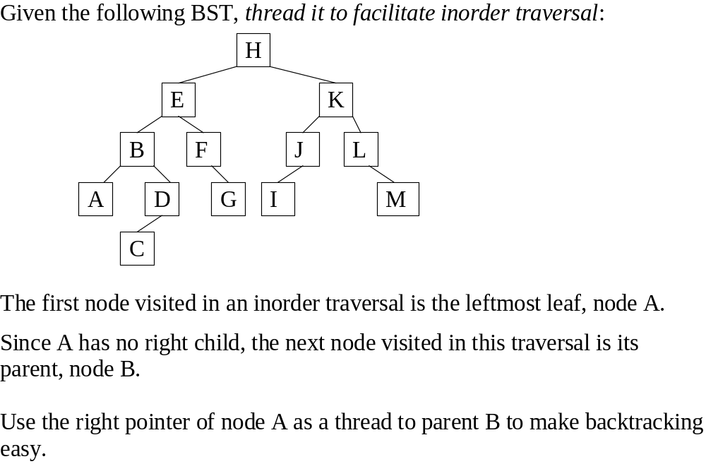
Threaded Binary Trees

Slide 28
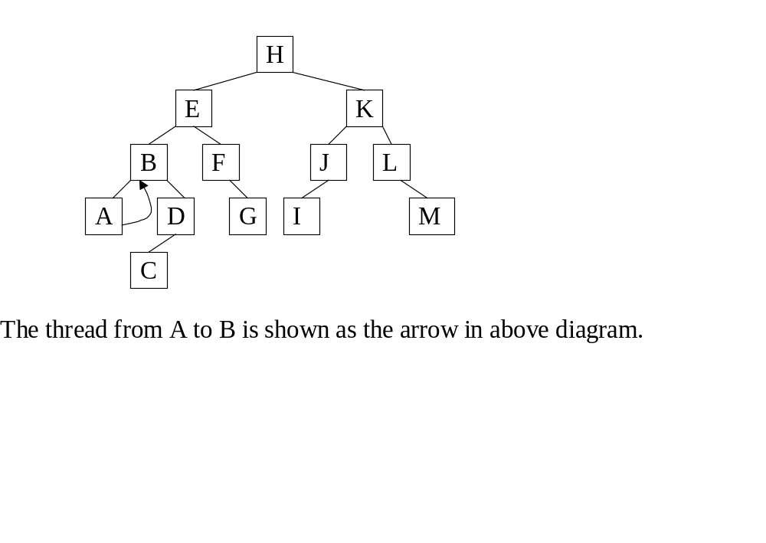
Threaded Binary Trees

Slide 29
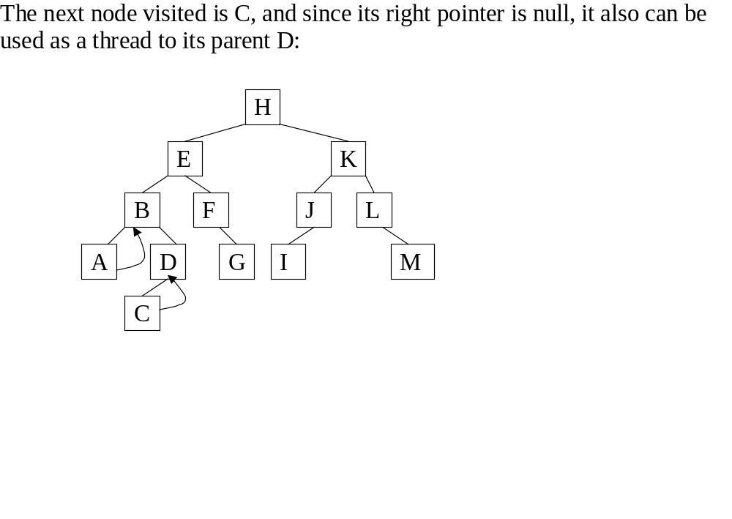
Threaded Binary Trees

Slide 30
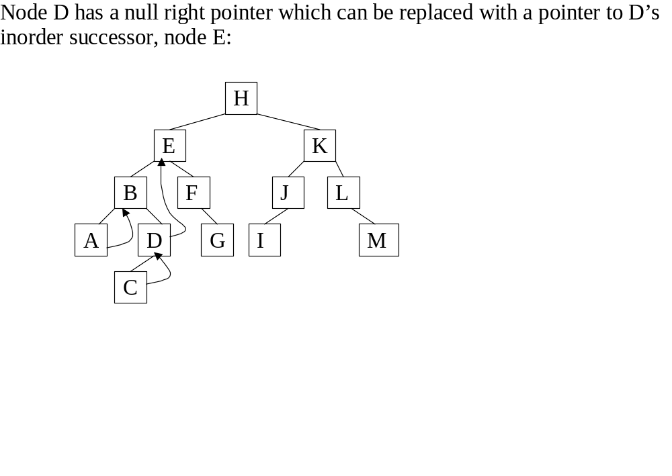
Threaded Binary Trees

Slide 31
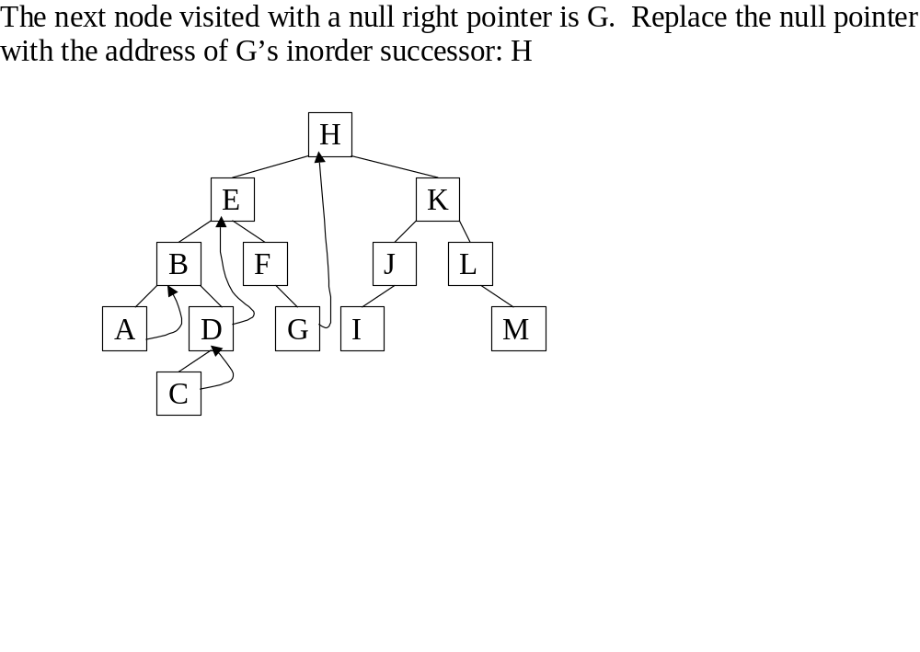
Threaded Binary Trees

Slide 32
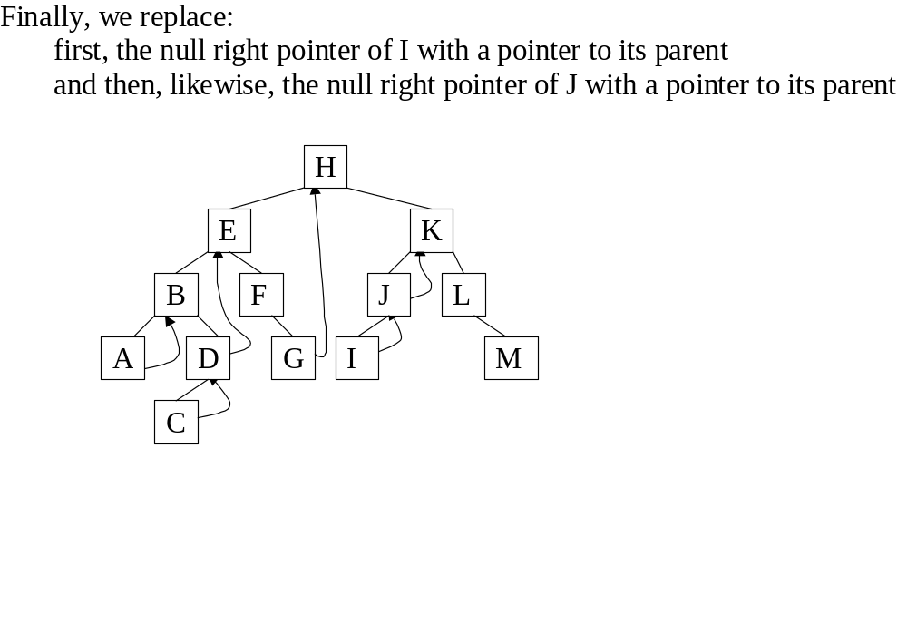
Threaded Binary Trees

Slide 33
Threaded Tree Example
6
8
3
1
5
7
11
9
13
Amir Kamil
8/8/02

Slide 34
Threaded Tree Traversal
We start at the leftmost node in the tree, print it, and follow its right thread
If we follow a thread to the right, we output the node and continue to its right
If we follow a link to the right, we go to the leftmost node, print it, and continue
Amir Kamil
8/8/02

Slide 35
Threaded Tree Traversal
Output
1
6
8
3
1
5
7
11
9
13
Start at leftmost node, print it
Amir Kamil
8/8/02

Slide 36
Threaded Tree Traversal
Output
1
3
6
8
3
1
5
7
11
9
13
Follow thread to right, print node
Amir Kamil
8/8/02

Slide 37
Threaded Tree Traversal
Output
1
3
5
6
8
3
1
5
7
11
9
13
Follow link to right, go to leftmost node and print
Amir Kamil
8/8/02

Slide 38
Threaded Tree Traversal
Output
1
3
5
6
6
8
3
1
5
7
11
9
13
Follow thread to right, print node
Amir Kamil
8/8/02

Slide 39
Threaded Tree Traversal
Output
1
3
5
6
7
6
8
3
1
5
7
11
9
13
Follow link to right, go to leftmost node and print
Amir Kamil
8/8/02

Slide 40
Threaded Tree Traversal
Output
1
3
5
6
7
8
6
8
3
1
5
7
11
9
13
Follow thread to right, print node
Amir Kamil
8/8/02

Slide 41
Threaded Tree Traversal
Output
1
3
5
6
7
8
9
6
8
3
1
5
7
11
9
13
Follow link to right, go to leftmost node and print
Amir Kamil
8/8/02

Slide 42
Threaded Tree Traversal
Output
1
3
5
6
7
8
9
11
6
8
3
1
5
7
11
9
13
Follow thread to right, print node
Amir Kamil
8/8/02

Slide 43
Threaded Tree Traversal
Output
1
3
5
6
7
8
9
11
13
6
8
3
1
5
7
11
9
13
Follow link to right, go to leftmost node and print
Amir Kamil
8/8/02

Slide 44
Threaded Tree Modification
We’re still wasting pointers, since half of our leafs’ pointers are still null
We can add threads to the previous node in an inorder traversal as well, which we can use to traverse the tree backwards or even to do postorder traversals
Amir Kamil
8/8/02

Slide 45
Threaded Tree Modification
6
8
3
1
5
7
11
9
13
Amir Kamil
8/8/02

